Slide 1

Python Diceware
Because Our Passwords Suck
Fernando Medina Corey
@fmcorey | fmcorey.com | github.com/fmcorey

Slide 2













Why Care About Passwords?
Interactions
Money
Code
Physical World

Slide 3
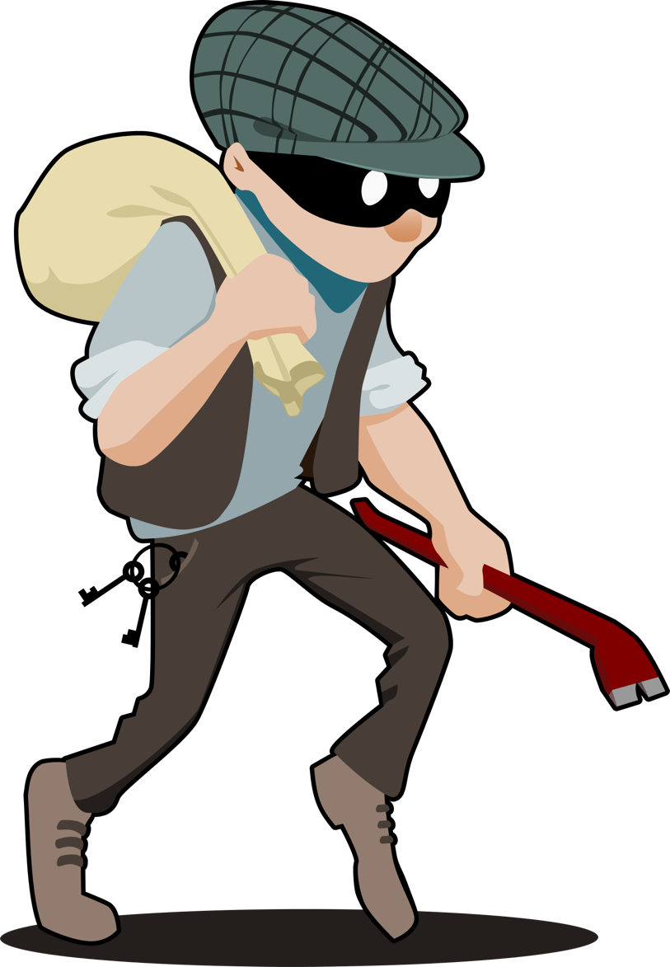
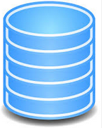

How Attacks Happen
Attack
Theft
Propagation
Attacks on or with the Database

Slide 4
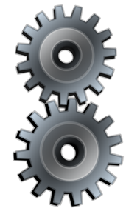
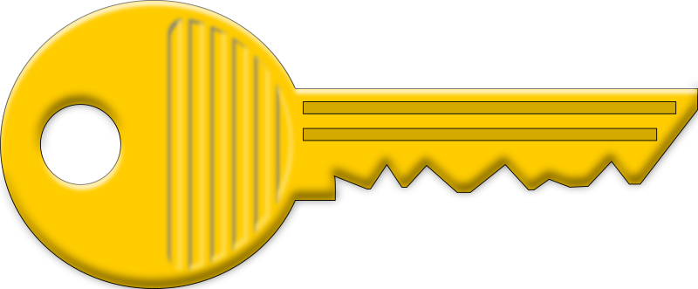
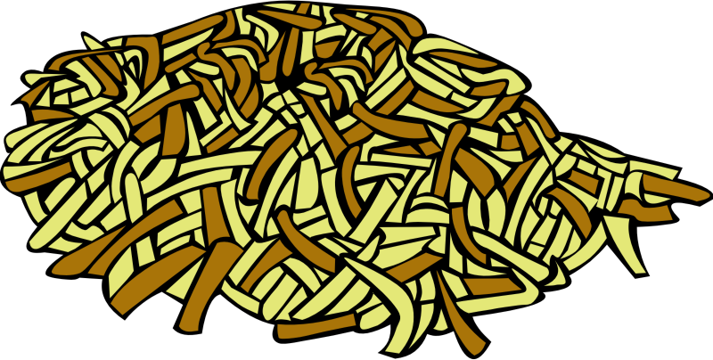
Password Hashes (stuff in the database)
Password → One Way Hashing Algorithm → Password Hash
‘little red riding hood’ → MD5 Hashing Algorithmn =
C64d7bb00f804b1cc118f7722c6c67e7
But there are some problems...

Slide 5
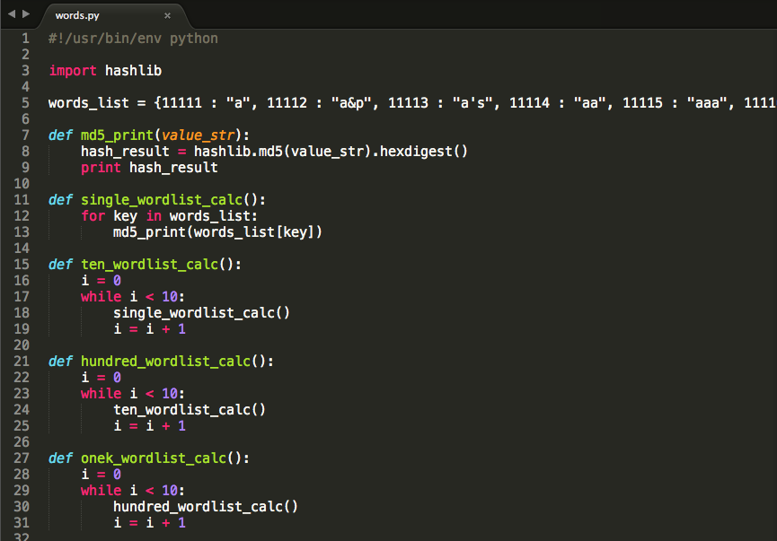
Testing Hashes
-hashlib
–md5
-How long does
this take?

Slide 6
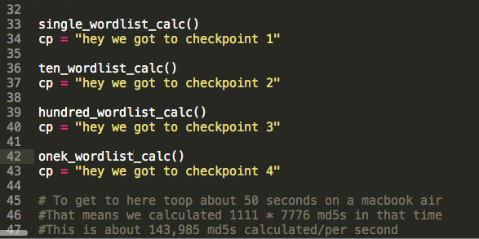
How quick can I calculate these?
-Ran this while
talking
-Calculates about
144K md5 hashes
per second
-md5 is fast
which is actually bad in this case

Slide 7
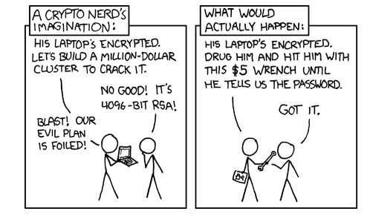
Master Password Considerations
Crackers know the ‘schemes’
myp455w0rd
gophillies
Rudolf123
Trillion Guesses Per Second
Link In a Chain
https://xkcd.com/538/

Slide 8
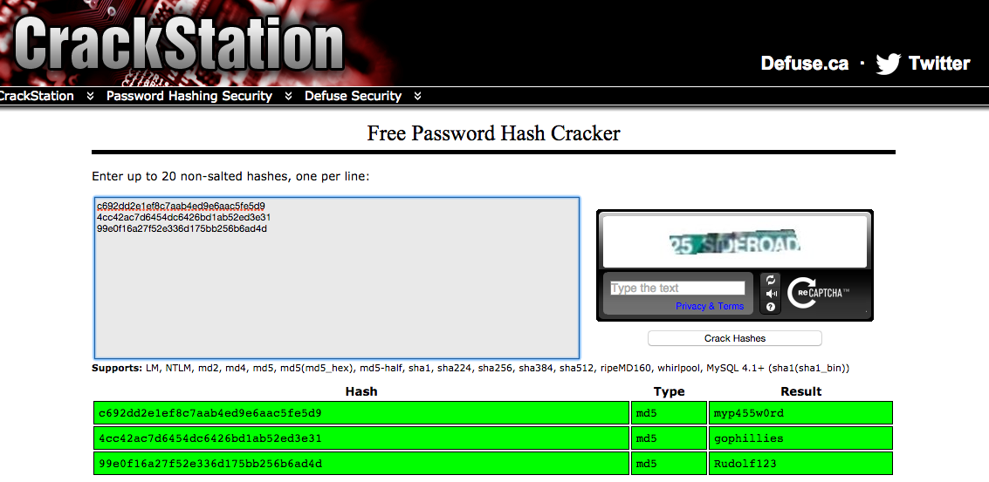

Slide 9
A Sample ‘Formula’
But my passwords are better…
Common Book Titles
(10 Million)
Special Characters
(50)
Birth Year
(10)
TheTwoTowers%1990
Total Possibilities: 5 Billion

Slide 10
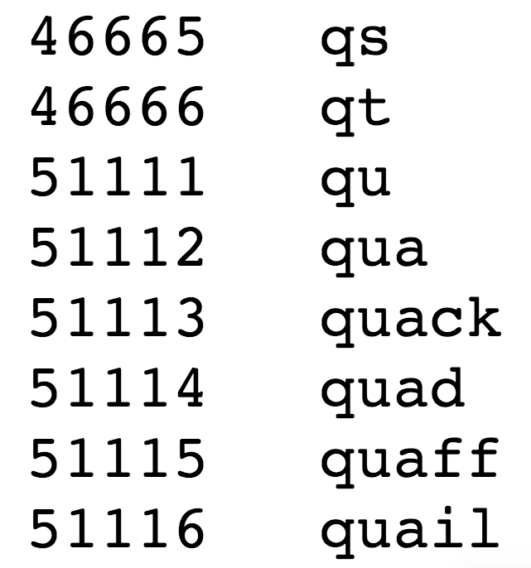
Diceware – Strong Memorable Passwords
Word List of 7776 Words
Roll Dice and Write Down Rolls
Lookup Random Rolls From Wordlist
Generate A Memorable Password!

Slide 11

Strength Analysis
Each Word has 7776 possibilities
Possibilities Modeled By 7776 ^ n
N is number of words in passphrase
Four | Thirty Minutes
Five | Five months
Six | 3,600 Years
Seven | 27 Million Years
Eight | The Universe Doesn’t Exist Anymore

Slide 12
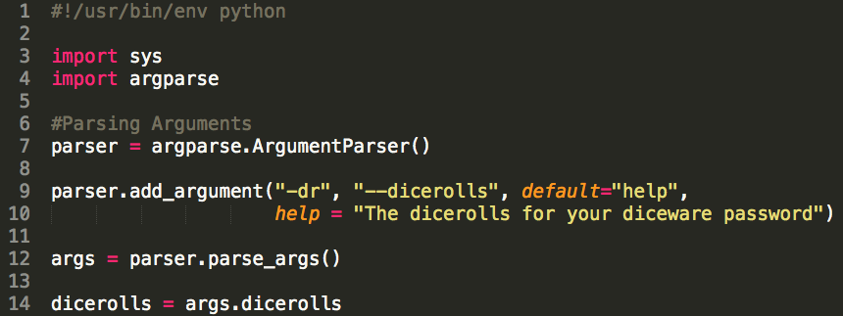
Writing Python Diceware – Components

Slide 13
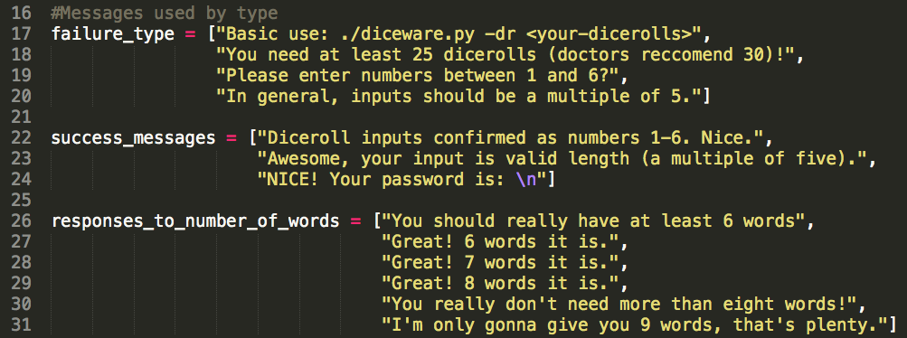
Messages

Slide 14
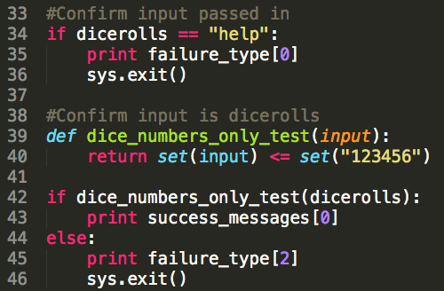
Validation

Slide 15
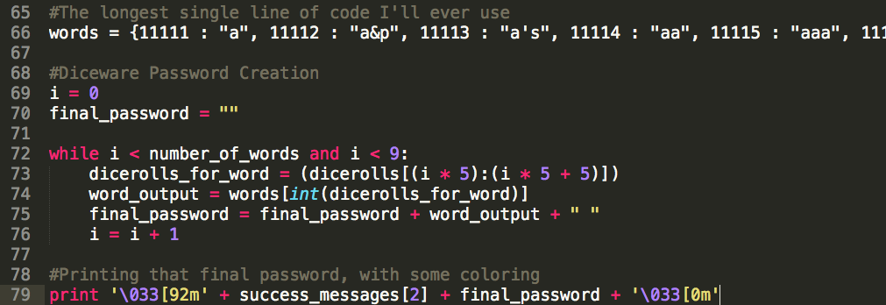
Generating the Password

Slide 16
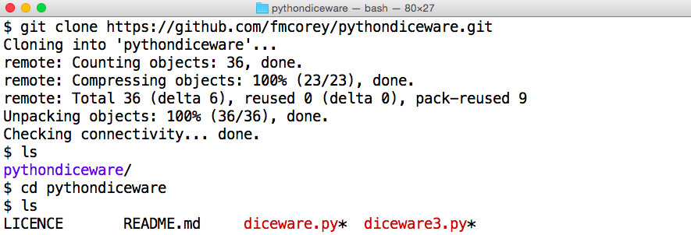
Putting it together

Slide 17
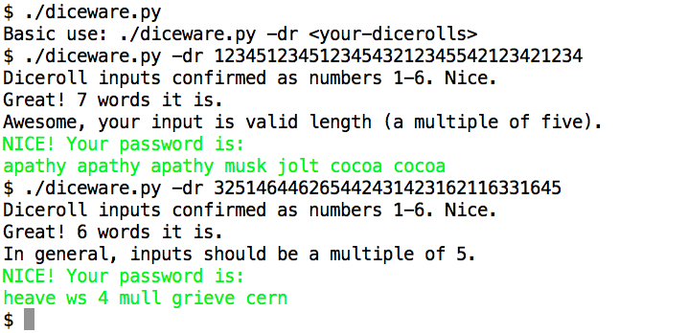
Generating the Password

Slide 18
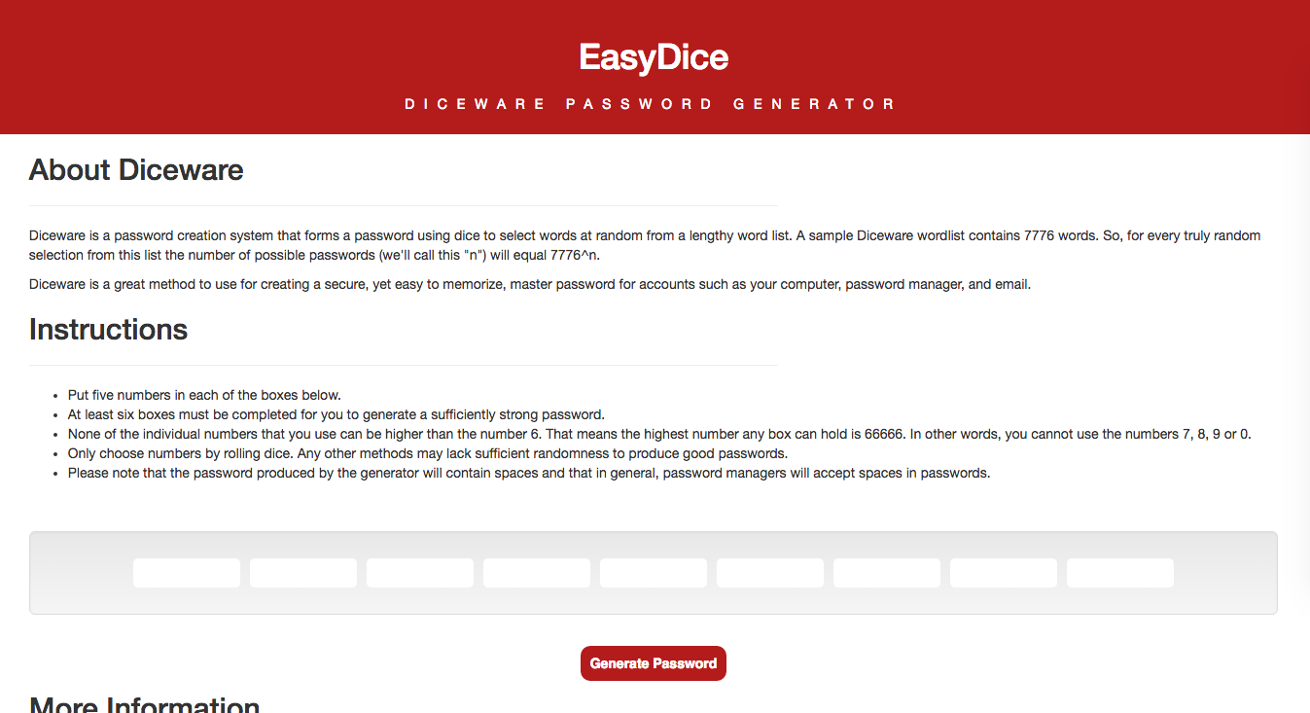

Slide 19
Considerations
.bash_history
Use Password Managers!
Use Two Factor Auth!
Don’t trust me! – Audit my code!

Slide 20
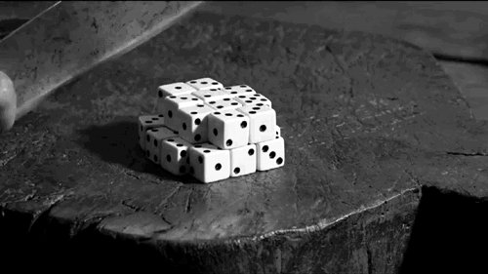
PRIZES FOR QUESTIONS

